Slide 1

Generative AI Architect Program
RAG-Based Solutions Using Generative AI

Slide 2
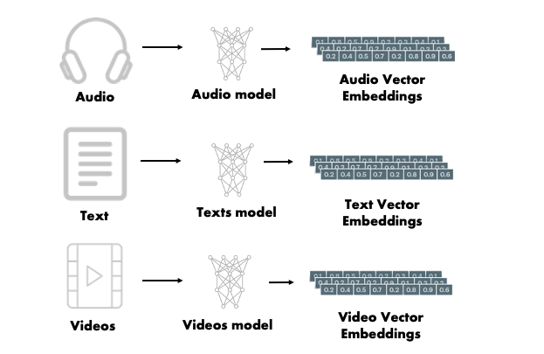
Retrieval Augmented Generation
Embeddings
Embeddings are a way to represent complex data like texts, images, or any kind of information into a list of numbers (a vector) that a computer can work with.

Slide 3
Retrieval Augmented Generation
Vector Embeddings
Vector embeddings are a way of converting items like words, sentences, or even entire documents into a series of numbers (a vector) so that a computer can understand and work with them.
These numbers represent the meaning of the items and their relationship to each other, allowing the computer to perform tasks such as finding similar words or understanding the topic of a document.

Slide 4
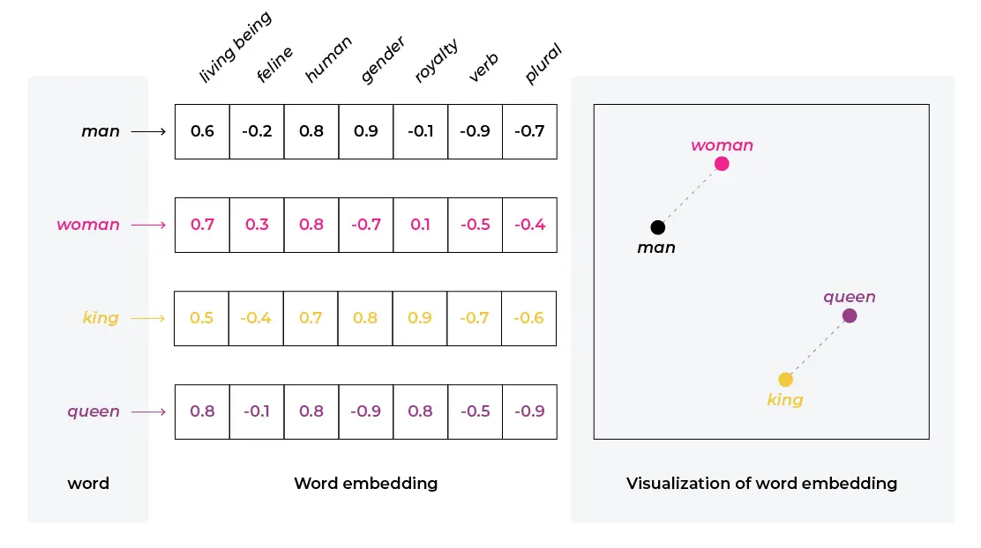




Retrieval Augmented Generation
Text Embeddings
A semantic relationship refers to the way words or phrases relate to each other in terms of meaning.
Example: Word2Vec is a popular model for generating word embeddings. If you take words like "king" and "man" and perform vector arithmetic by subtracting "man" from "king" and then adding "woman," you often get a result close to the vector for "queen."

Slide 5
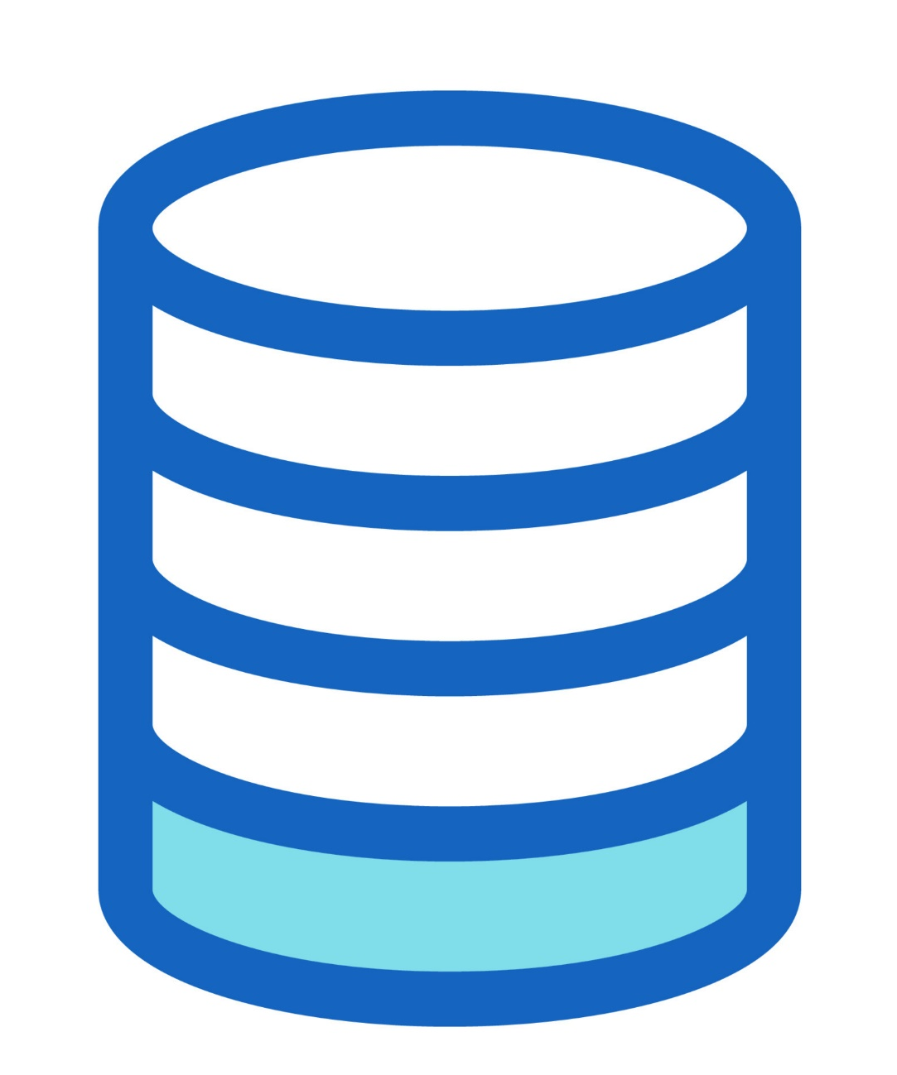
Retrieval Augmented Generation
Role of Vector Database in AI
In machine learning, particularly in areas like natural language processing (NLP) and computer vision, data is often transformed into vectors using models like word embeddings or image embeddings.
Vector databases allow for efficient storage and retrieval of these embeddings, enabling features like similarity search, where you can query database with a vector and find other vectors that are similar to it.
Vector databases are optimized for vector-specific operations, such as cosine similarity, Euclidean distance, and nearest neighbor search.
This all makes them suitable for applications like recommendation systems, image recognition, and semantic text search.

Slide 6
Retrieval Augmented Generation
Vector Databases
 | Vector Database | Traditional Database
Data Representation | Stores data as high-dimensional vectors, representing complex relationships and similarities between data points. | Stores data in structured formats such as tables with rows and columns, often relying on relational models.
Querying Approach | Utilizes similarity-based queries, where vectors closely resembling a query vector are retrieved based on distance or similarity metrics. | Typically uses exact matching queries based on specified criteria, such as SQL queries.
Data Types | Capable of handling diverse data types including text, images, audio, and more, by converting them into numerical representations (vectors). | Suited for structured data types like text, numbers, and dates.
Indexing & Retrieval | Utilizes specialized indexing techniques like k-NN, LSH, or HNSW to efficiently retrieve vectors based on similarity metrics. | Relies on indexing methods optimized for structured data, such as B-tree or hash-based indexing.

Slide 7

Vector Databases
Pinecone
Pinecone is a vector database specifically designed for machine learning applications.
It's built to handle the complexities of vector search at scale, enabling efficient management and retrieval of high-dimensional data.
Pinecone is often used in scenarios where similarity search is essential, such as recommendation systems, image and text retrieval, and anomaly detection.

Slide 8
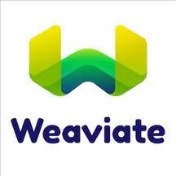
Vector Databases
Weaviate
Open Source
GraphQL Integration
Multi-modal Capabilities
Semantic Understanding
Hybrid Search
Unlike Pinecone's managed service approach, Weaviate is fully open-source and can be self-hosted or used via Weaviate Cloud Services.
Weaviate natively supports GraphQL queries, making it developer-friendly for complex data relationships and filtering.
It can handle different data types (text, images, audio) in the same database with built-in vectorization modules.
Weaviate focuses heavily on semantic search and understanding context, not just similarity matching.
Combines vector search with traditional keyword search and filtering for more precise results.

Slide 9
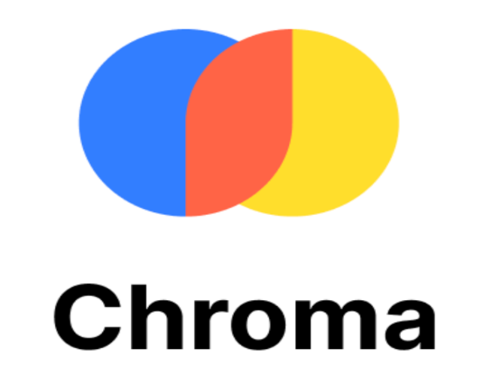
Vector Databases
Chroma
Chroma is an open-source vector database designed specifically for storing and retrieving high-dimensional vector data.
Unlike traditional relational databases, which struggle with vector representations, Chroma is optimized for vector operations and supports efficient nearest neighbor search, a critical capability for many AI applications.

Slide 10
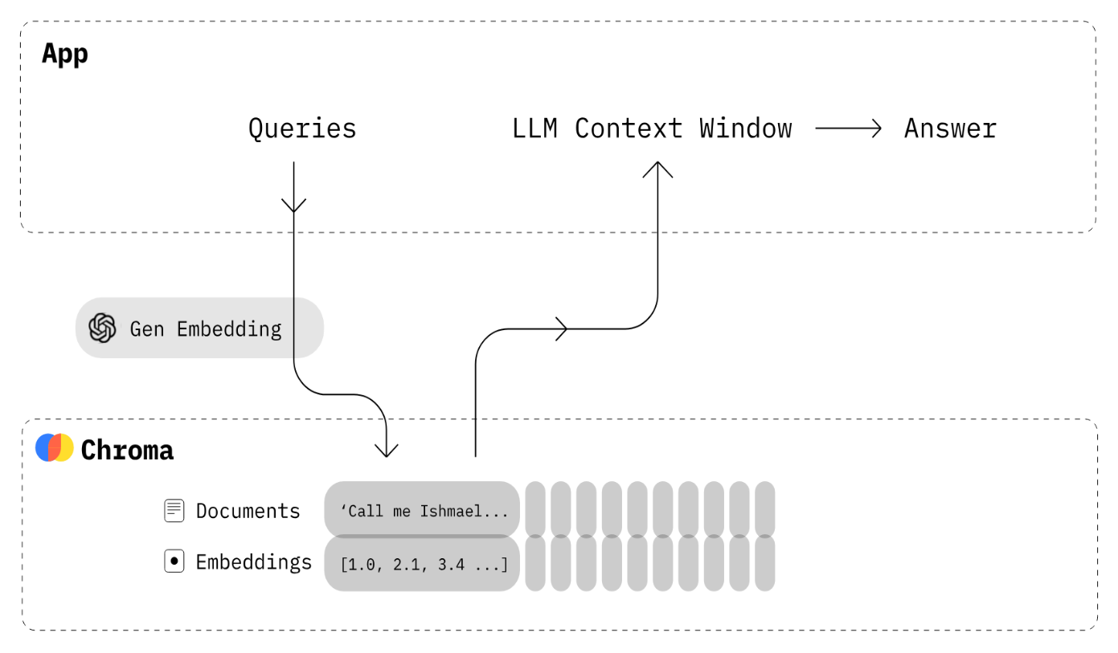
Chroma
Key Features
Open-source and Free
Scalability and Performance
Flexibility
Simplicity and Analysis
Cross-Platform Support
Chroma is free to use and modify, allowing for customization and community-driven improvements.
Chroma handles large datasets efficiently and offers fast retrieval times for nearest neighbor searches.
Chroma supports multiple storage options (DuckDB for standalone, Click House for scalability) and various embedding models (Sentence Transformers, OpenAI, Cohere, custom models).
Chroma is user-friendly, with straightforward APIs and visualization tools to explore and analyze data relationships.
Chroma works on Linux, macOS, and Windows, offering easy integration with various development environments.

Slide 11
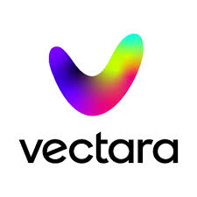
Vector Databases
Vectara
Vectara is a cloud-based vector search platform designed for creating and managing sophisticated search and recommendation systems.
It's particularly geared towards enterprise-level applications, offering features and capabilities that support complex, high-volume search requirements.

Slide 12
Why RAG?
LLMs come with certain specific challenges/limitations, when it comes to enterprise use:
Hallucinations
Knowledge Cutoff
Domain/organization Specificity
Fine Tuning/Re-training
Knowledge Access Management
Time Cutoff

Slide 13
















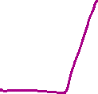



RAG
Pipeline 1: Data Ingestion pipeline
Pipeline 2: Realtime inference pipeline

Slide 14
Retrieval Augmented Generation
Why RAG?
LMs can reason about wide-ranging topics, but their knowledge is limited to the public data up to a specific point in time that they were trained on.
If you want to build AI applications that can reason about private data or data introduced after a model’s cutoff date, you need to augment the knowledge of the model with the specific information it needs.
The process of bringing the appropriate information and inserting it into the model prompt is known as Retrieval Augmented Generation (RAG).

Slide 15
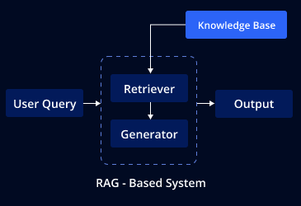
Retrieval Augmented Generation
Why RAG?
Hybrid Model
RAG is a hybrid model that brings together the strengths of both retrieval-based and generative approaches in NLP.
Retriever Component
The retriever is responsible for fetching relevant documents or data snippets that might contain the information needed to answer a question or address a query. This component typically uses techniques like semantic search to find documents that are contextually similar to the input query.
Generator Component
The generator then takes the context provided by the retriever and generates a coherent and contextually accurate response. This part of the model is often a large language model, similar to those used in generative AI for text generation.

Slide 16
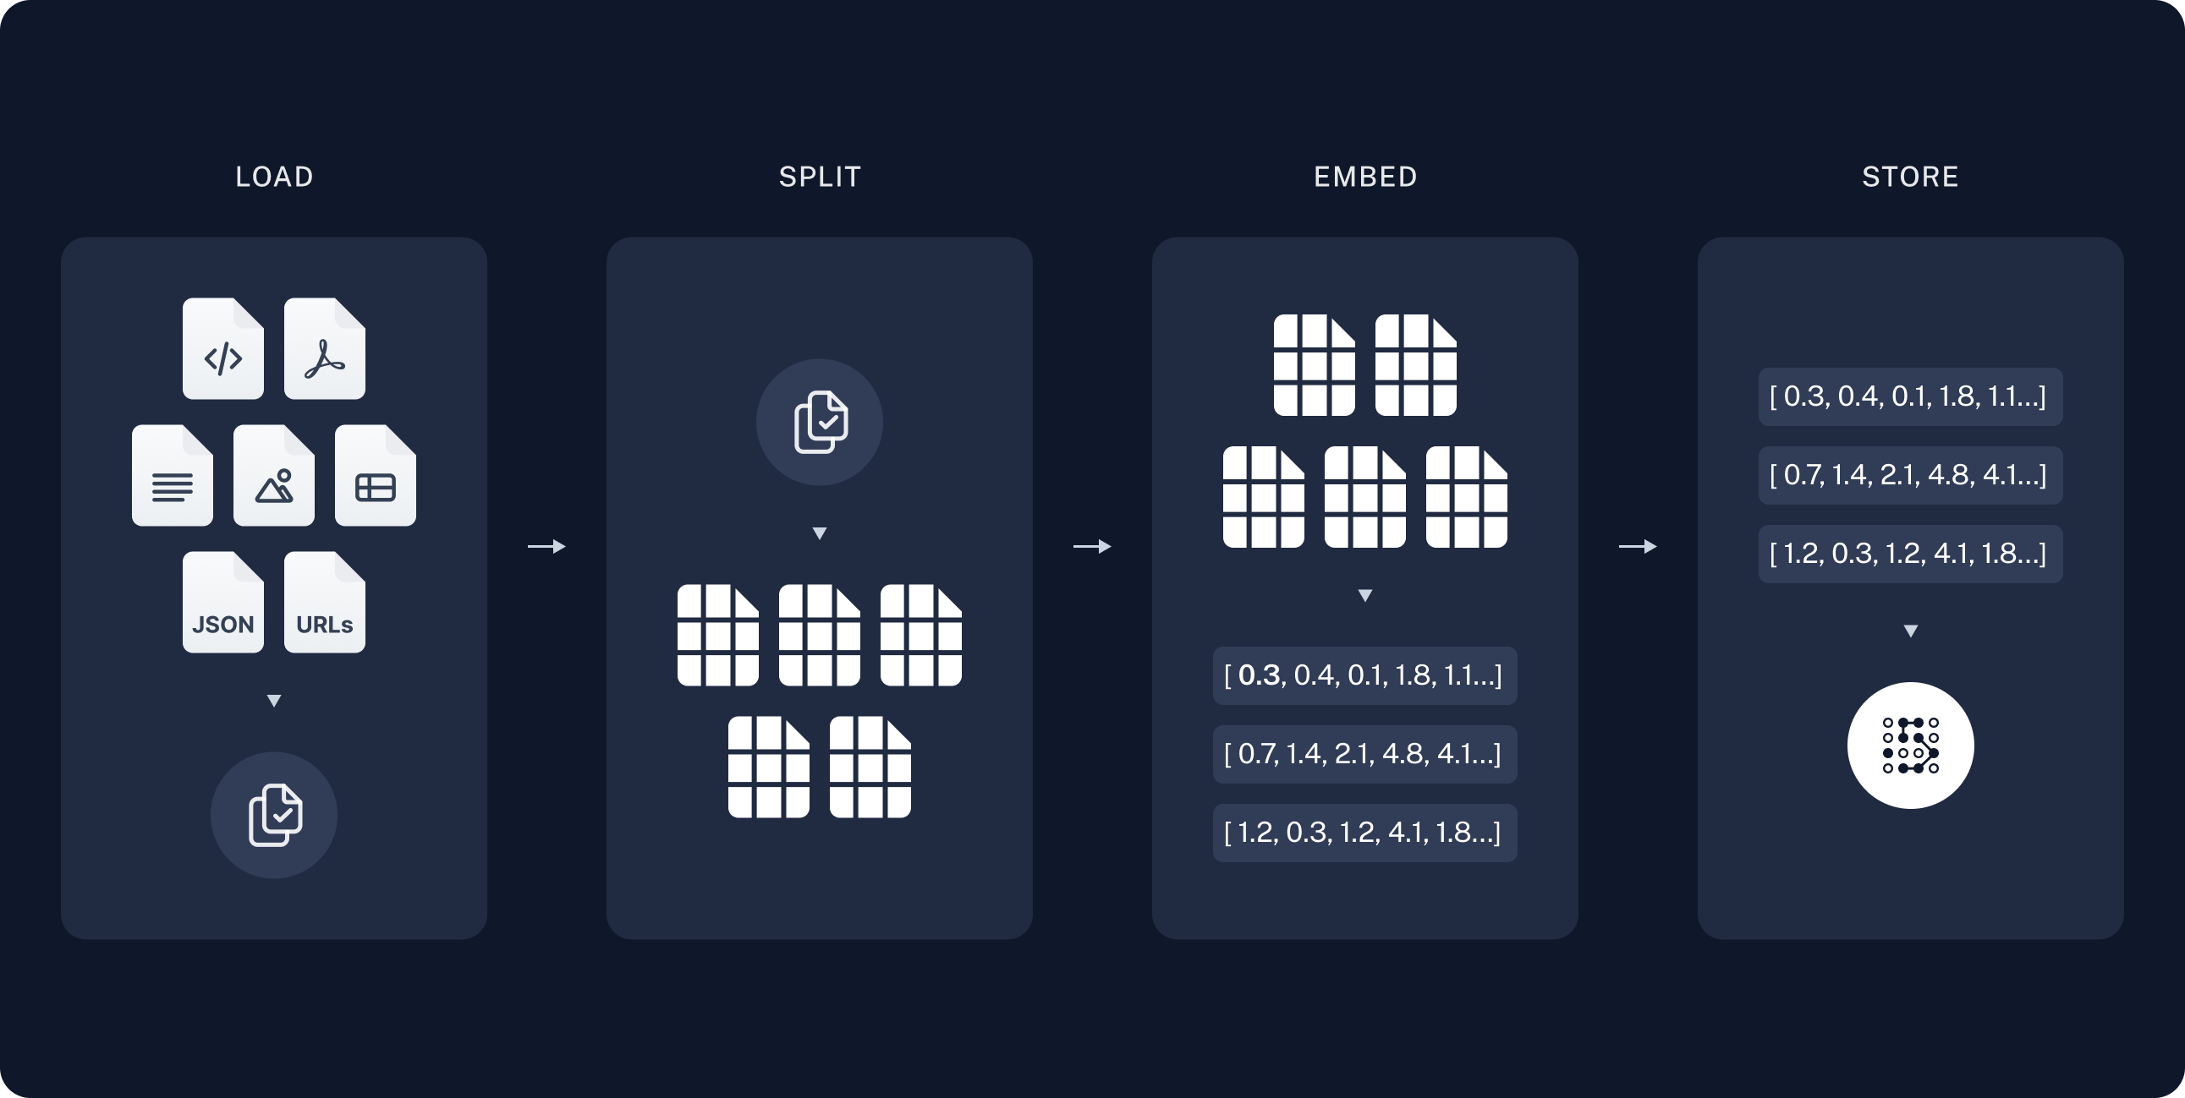
Retrieval Augmented Generation
Architecture of RAG - 1
Indexing: a pipeline for ingesting data from a source and indexing it. This usually happens offline.
Load
Split
Store
Notes:
Load: First, we need to load our data. This is done with DocumentLoaders.
Split: Text splitters break large Documents into smaller chunks. This is useful both for indexing data and for passing it in to a model, since large chunks are harder to search over and won’t fit in a model’s finite context window.
Store: We need somewhere to store and index our splits, so that they can later be searched over. This is often done using a VectorStore and Embeddings model.

Slide 17
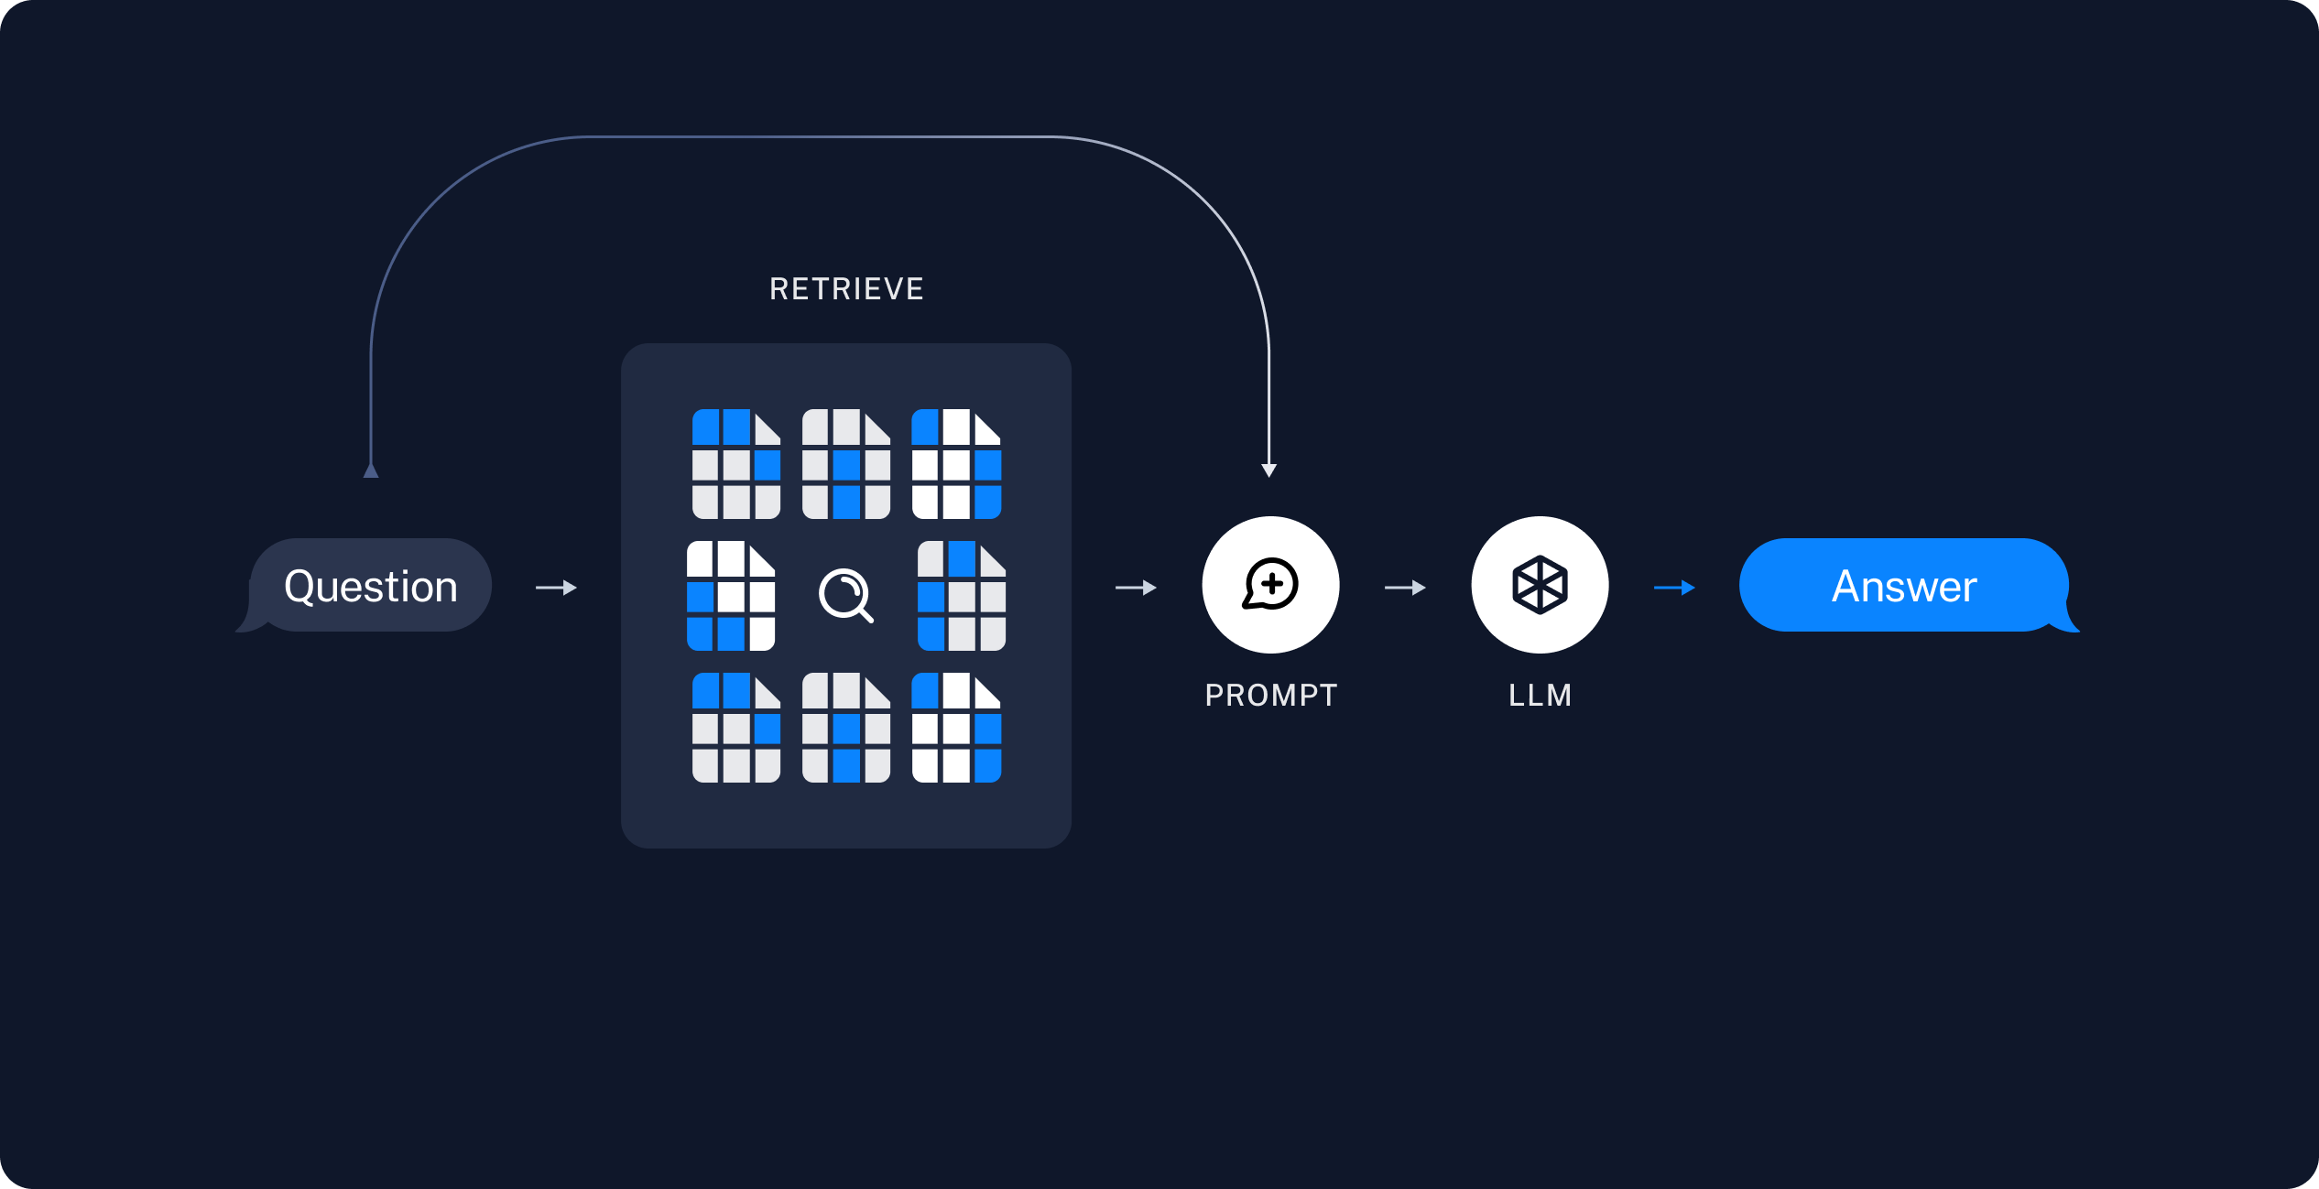
Retrieval Augmented Generation
Architecture of RAG - 2
Retrieval and generation: the actual RAG chain, which takes the user query at run time and retrieves the relevant data from the index, then passes that to the model.
Retrieve
Generate
Notes:
Retrieve: Given a user input, relevant splits are retrieved from storage using a Retriever.
Generate: A ChatModel / LLM produces an answer using a prompt that includes the question and the retrieved data

Slide 18
Retrieval Augmented Generation
How RAG works?
1
Input Processing
When a query or a question is input into a RAG model, the retriever first processes this input.
2
Data Retrieval
The retriever searches a database or a document set to find relevant information.
This database could be a pre-compiled corpus of text, like Wikipedia or a specialized knowledge base.
3
Context Integration
Large language models achieve impressive performance on diverse tasks, such as translation, summarization, conversation, and even coding.
4
Response Generation
The generator model, using both the original query and the context from the retrieved documents, generates a response that is informed by this additional data.

Slide 19
Retrieval Augmented Generation
Applications of RAG
Question Answering Systems: RAG is particularly effective in question-answering systems where the answer might not be contained in a single document or may require synthesis from multiple sources.
Information Retrieval: Enhancing search systems to provide more relevant results by combining retrieval with generation.
Chatbots and Virtual Assistants: Improving the quality of responses in conversational AI by providing more accurate and detailed answers.

Slide 20
Retrieval Augmented Generation
Vector Databases
Tool | License | Deployment Model | Indexing & Query | Scalability | SDK / Language Support | Best For
Pinecone | Proprietary | Fully managed cloud-only | ANN (HNSW, IVF) + hybrid vector+keyword | Billions of vectors via serverless shards | Python, Go, Java, Node.js, C# | Enterprise-grade similarity search at scale
Weaviate | BSD-3-Clause | Self-host (k8s/Docker) or managed Weaviate Cloud | HNSW (default) & flat indexes; semantic + hybrid via GraphQL/REST | Sharded clusters for billions of vectors | Python, TypeScript/JavaScript, Go, Java | Semantic search & knowledge-graph use cases
Qdrant | Apache-2.0 | Self-host (Docker/K8s) or Qdrant Cloud | HNSW with metadata filtering & payload indexes | Sustained high throughput & low latency clusters | Python, Rust, Go, TypeScript, Java, C# | Filterable similarity search in production
Redis Vector Search | Redis Source Available License (RSAL) | Embedded in Redis; self-managed or via Redis Cloud | KNN vector search (HNSW) via FT.SEARCH; vector+text filtering | Scales to billions with sharded clusters & HNSW tuning | Any Redis client: Python, Java, Node.js, Go, .NET | Lightning-fast vector search in existing Redis deployments
ChromaDB | Apache-2.0 | Docker, serverless (Cloud Run) or embed in Python app | In-memory ANN (HNSW) + persistent object store; cosine/Euclidean | Suited for small to medium projects & prototyping | Python | Lightweight prototyping & small-scale similarity apps
Faiss | MIT License | Embedded/in-process library | Exact (Flat) & ANN (IVF, HNSW, PQ) with GPU acceleration | Handles billions of vectors with CPU & GPU support | Python, C++ | High-performance research & large-scale similarity search
Azure Cognitive Search | Proprietary (Microsoft-managed PaaS) | Fully managed cloud PaaS | Nearest Neighbors ANN on vector fields | Scales via search units (partitions & replicas) for millions of docs & vectors | .NET, Java, Python, JavaScript, REST API | Enterprise-grade PaaS vector search integrated with Azure
Vertex AI Vector Search | Proprietary (Google-managed PaaS) | Fully managed cloud-only PaaS | ANN based on Google's ScaNN with filtering & real-time updates | Billions of vectors with autoscaling & ultra-low latency | Python, Java, Node.js, Go, REST API | Massive-scale, high-performance search integrated with Google Cloud

Slide 21
Retrieval Techniques
Sparse Retrieval
What it is
Looks for exact keyword matches between your query and documents.
How it works
Think of scanning printed index cards: you flip through and pick cards that contain the exact words you asked for.
Example
If you search for “apple pie recipe,” sparse retrieval finds documents containing the words “apple,” “pie,” and “recipe.” It won’t surface a document titled “Grandma’s Famous Fruit Tart,” even if it describes an apple dessert.

Slide 22
Retrieval Techniques
Dense Retrieval
What it is?
Combines sparse and dense methods to get the best of both worlds.
How it works
Sparse pass: Quickly filters for documents with keyword overlap (fast, precise on keywords).
Dense pass: Ranks those (or all) documents by semantic similarity (captures meaning).
Fusion: Merges scores (e.g., adds or weights them) so top results are both keyword-relevant and semantically related.
Why use it
Catches exact matches (via sparse) for precise queries.
Also surfaces paraphrases or related content (via dense) when keywords differ.
Example: You search “child care benefits.”
Sparse part grabs docs mentioning “child,” “care,” “benefits.”
Dense part boosts a policy document titled “Family Support Allowances” because its meaning aligns closely.
Hybrid ranking ensures you see both direct hits (e.g., “child care benefits guide”) and semantically relevant ones (e.g., “family support allowances overview”).

Slide 23
RAG Evaluation
Functional Metrics
Metric | Description
Precision@K | Fraction of the top-K retrieved documents that are truly relevant.
Recall@K | Proportion of all relevant documents that appear in the top-K results.
Mean Reciprocal Rank (MRR) | Average inverse rank of the first relevant document.
nDCG | Quality of ranking based on relevance and position.
Exact Match | Percentage of generated answers that exactly match a reference answer.
F1 Score | Harmonic mean of precision and recall on answer correctness.
Hallucination Rate | Proportion of answers containing unsupported or fabricated content.
Answer Completeness | Degree to which responses cover all aspects of the user’s query.
Semantic Similarity | Average embedding-based similarity between generated and reference answers.
User Satisfaction Score | Average rating (e.g., 1–5) provided by end users on answer usefulness.

Slide 24
RAG Evaluation
Operational Metrics
Metric | Description
Latency | Average time from user request to final answer delivery.
Throughput | Number of RAG queries processed per second.
Error Rate | Percentage of requests resulting in system failures or unusable outputs.
System Uptime | Proportion of time the service is available and responsive.
Token Consumption | Average number of input + output tokens used per query.
CPU/GPU Utilization | Percentage of compute resources in use during peak loads.
Cache Hit Rate | Share of retrievals served from a fast cache vs. full datastore lookups.
Document Fetch Time | Average time to retrieve external documents or embeddings.

Slide 25
What can go wrong in RAG?
User’s question is not correctly framed? – user has provided incomplete information
User’s question is complete (8-12 words), but is inefficient in finding similarity and retrieving docs.
Vector DB does not have relevant docs related to the query

Slide 26
What can go wrong in RAG?
User’s question is not correctly framed? – user has provided incomplete information
Agentic RAG Architecture
User’s question is complete (8-12 words), but is inefficient in finding similarity and retrieving docs.
Add a feature for Query rewriting with the help of LLM. Again perform retrieval
Optimize the retrieval technique: use hybrid retrieval
Vector DB does not have relevant docs related to the query
Seach for additional information over internet (or any other 3rd party source).

Slide 27
User’s question is not correctly framed? – user has provided incomplete information
User’s question is complete (8-12 words), but is inefficient in finding similarity and retrieving docs.
Vector DB does not have relevant docs related to the query

Slide 28
What can go wrong with RAG?
Retriever process - inefficient – not retrieving right docs
User’s question is not correctly framed? – user has provided incomplete information
Use Chat mode / Agentic Mode to ask question to capture details / ask user to rephrase
User’s question is complete (8-12 words), but is inefficient in finding similarity and retrieving docs.
Query Rewriting
Vector DB does not have relevant docs related to the query
Use internet search to get more/ real time data OR use 3rd party sources
Search Algorithm is not efficient in search right docs
Use better algorithms like Hybrid search
Generation Process – inefficient – retrieved docs are good, but llms not able to articulate it
LLM answers questions from out of context
Improve the prompt template, add more guidance, constraints
LLM is not able to extract answer from retrieved docs

Slide 29
User
(question)
Retriever
Vector DB (chroma)
Grader: checker
Compare question with documents: yes/no
Refined=False
(set to True)
For checker:no
Query is inefficient: needs to be elaborated Solution: refine query
Vector DB does not have relevant documents for the query Solution: web search to get docs
Query Rewriter
Grader: No
Grader: yes
Refined=True
Web Search
Generator
CRAG: Corrective RAG

Slide 30
CRAG: Corrective RAG
User
(question)
Retriever
Vector DB (chroma)
Compare question with documents: yes/no
Grader: checker
Refined=False
(set to True)
For checker: no
Query is inefficient: needs to be elaborated Solution: refine query
Vector DB does not have relevant documents for the query Solution: web search to get docs
Grader: No
Query Rewriter
Grader: yes
Refined=True
Web Search
Generator

Slide 31
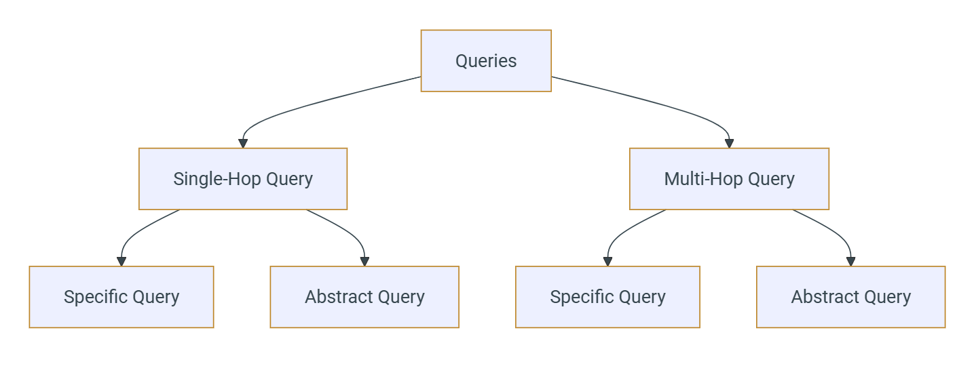

Slide 32
RAG Evaluation: Retrieval Engine Evaluation
How should our test data (evaluation data) look like for this evaluation
User Query | Ideal Documents (Ground Truth) | Retrieved Documented by RAG Engine
Query 1 | Doc 1, Doc4 | Doc 1, Doc4, Doc5
Query 2 | Doc 3, Dco2, Doc8 | Doc 2, Doc5, Doc 3
Query 3 | Doc 1
Query 4 | Doc 4, Doc 5
Query 5 | Doc 3, Doc6

Slide 33
Dataset for RAG Evaluation
Actual query Actual docs
Query1 doc1
Query2 doc1,doc4
Query3 doc8
Query4 doc9,doc3

Slide 34
Evaluation Data
Actual query | Actual docs | Retrieved docs
q1 | D1 | D3,d4
Q2 | D2
Q3 | D4
Q4 | D2
q5 | d6

Slide 35





Advanced RAG: Pre-Retrieval Patterns
1. Query Transformation
2. Optimized Indexing
Optimizes the user query before retrieval to improve search relevance.
Improves how documents are chunked and embedded before retrieval.
Query Expansion
Content-Aware Chunking
Broadens query with synonyms or related terms
Splits based on document structure (paragraphs, headings) instead of fixed size
Example:
"Apple stock investment" → "AAPL financial prospects", "Apple
earnings analysis", "tech stock risks"
Small-to-Large Chunking
Indexes small chunks for precise retrieval, provides larger parent chunks for context
Query Decomposition
Breaks complex questions into simpler sub-questions
Pros:
Preserves semantic integrity, balances precision with context
Cons:
Increased indexing complexity, requires parent-child relationship
tracking

Slide 36





Advanced RAG: Retrieval Stage Patterns
1. Hybrid Search
2. Graph RAG
Combines different search algorithms to leverage their respective strengths. The most common approach is to use keyword-based search (like BM25) in parallel with vector search.
Uses a Knowledge Graph (KG) where entities are nodes and relationships are edges. An LLM extracts entities from the query and traverses the graph to find relevant sub-graphs.
Keyword Search:
Excels at finding specific terms, acronyms, or
Pro:
Extremely precise for relationship questions
IDs
Con:
High cost of creating and maintaining the knowledge graph
Vector Search:
Excels at finding semantically related concepts
Example:
Query: "Who is the CEO of the company that makes
the Model S?"
1. Extract entities: "CEO", "company", "Model S"
2. Graph traversal: Model S → is_made_by → Tesla → has_ceo
→ Elon Musk

Slide 37



Advanced RAG: Post-Retrieval Patterns
1. Re-Ranking
2. Prompt Compression
Refines retrieved documents using a second, more powerful model to improve relevance.
Extracts only the most salient information from retrieved contexts to reduce noise and token usage.
1
Retrieve larger set of documents (e.g., top 25)
1
Analyze retrieved documents
2
Use cross-encoder to score document-query relevance
2
Extract only query-relevant sentences
3
Select new top-k documents for the LLM
3
Combine compressed snippets for LLM
Pros:
Cons:
Pros:
Cons:
Significantly improves context quality
Adds latency
Reduces token costs
Risk of removing important context
Increases computational cost
Mitigates "lost in the middle" problem
Reduces noise in retrieved content
Additional processing overhead

Slide 38

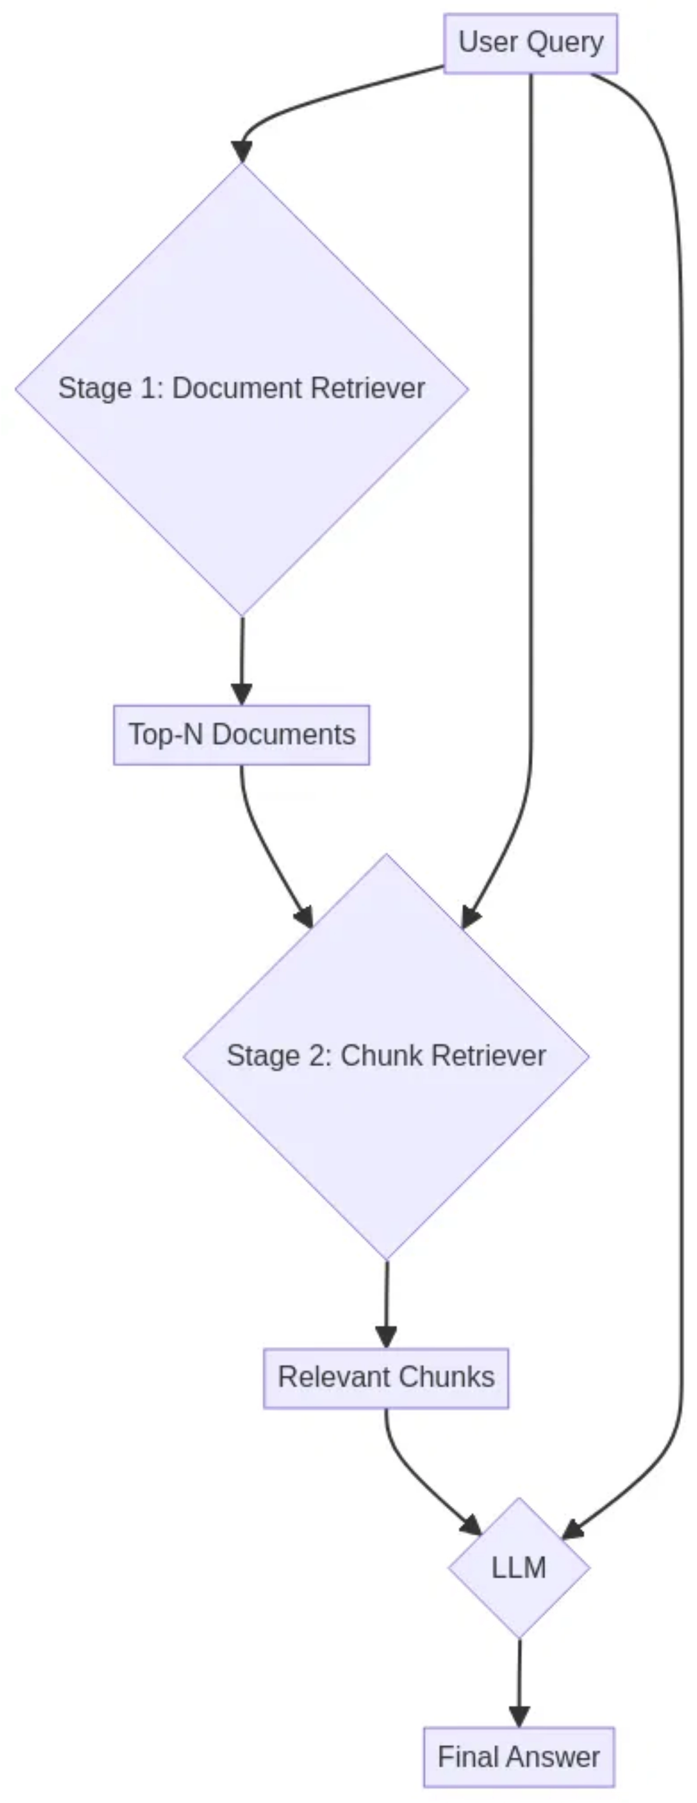



Advanced RAG: Hierarchical Retrieval
Also known as Parent-Child Retrieval, this two-stage pattern combines the strengths of document-level and chunk-level RAG to improve speed and precision, especially for large document collections.
Stage 1: Coarse Retrieval
An efficient search (often using BM25 or coarse embedding) finds the most relevant high-level documents from the entire corpus.
Stage 2: Fine-Grained Retrieval
A more precise search runs only on chunks within the top documents from Stage 1 to find the exact answer-bearing passages.
Pro:
Balances speed and precision for very large document collections
Pro:
Leverages document structure (e.g., find handbook, then section)
Con:
Increased implementation complexity

Slide 39

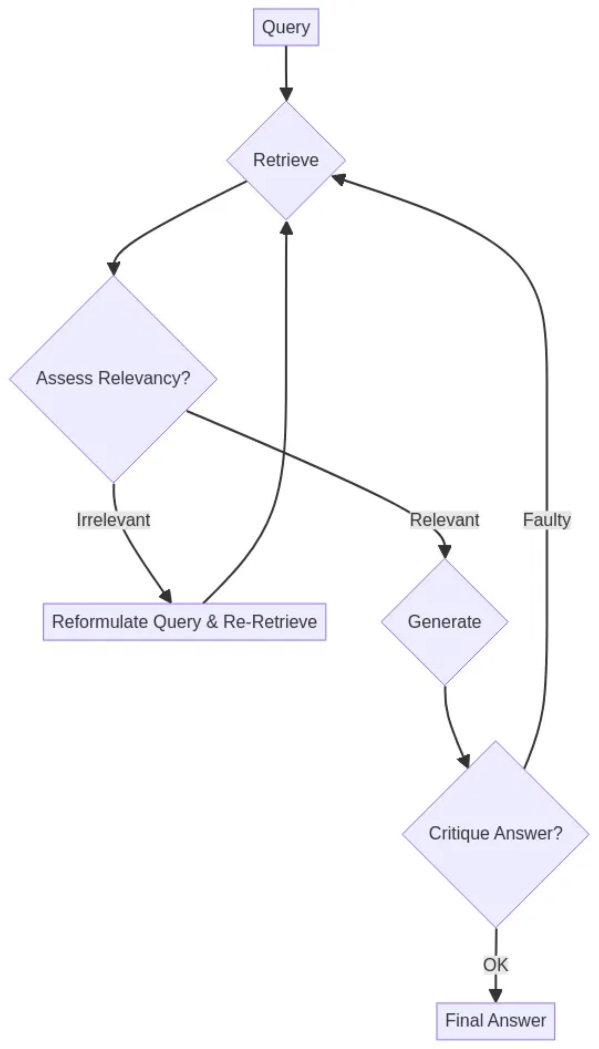




Advanced RAG: Iterative / Self-Correcting RAG
This meta-pattern creates a loop of reflection and correction, making the RAG process more robust and dynamic. It enables the system to evaluate the quality of its own work and adapt its strategy.
Key Concepts
Reflection & Critique:
LLM evaluates retrieved documents
and generated answers
Decision Making:
System decides whether to reformulate
query, re-retrieve, or re-generate
Pros:
Cons:
Highly robust and adaptive
Complex implementation
Reduces hallucinations
Higher latency and cost

Slide 40

Summary of RAG Patterns
Pattern Name
Stage
Key Idea
Best For
Main Pro
Main Con
Naive/Basic RAG
Core
Retrieve top-k chunks and generate
Simple Q&A, Proof-of-concepts
Simple and fast
Brittle, low precision
Query Expansion
Broaden query with related terms
Vague or ambiguous queries
Increases recall
Can add noise
Pre-Retrieval
Query Decomposition
Break complex query into sub-queries
Multi-part or comparative questions
High accuracy for complexity
High latency, complex logic
Pre-Retrieval
Hybrid Search
Combine vector and keyword search
Queries with specific keywords/IDs
Best-of-both-worlds relevance
Requires two search systems
Retrieval
Re-Ranking
Use a second model to re-order initial results
When precision is critical
Improves context quality
Adds latency
Post-Retrieval
Hierarchical Retrieval
Document-level then chunk-level search
Very large document collections
Balances speed and precision
Increased complexity
Retrieval
Iterative/Self-RAG
Loop of retrieve-assess-generate-critique
Mission-critical applications
Extremely robust and adaptive
Very complex and slow
Meta-Pattern

